Slide 1
Edesia
Sprint Retrospective #4
Team Blue
Adam Bowers | Daniel Wingo | Stephen Bennett | Jonathan Holley
Github: aLotofAdam | 81wingo | stephenbennett2 | mccauley747
UNCG: ajbower3 | dtwingo | scbenne3 | jbholley

Slide 2
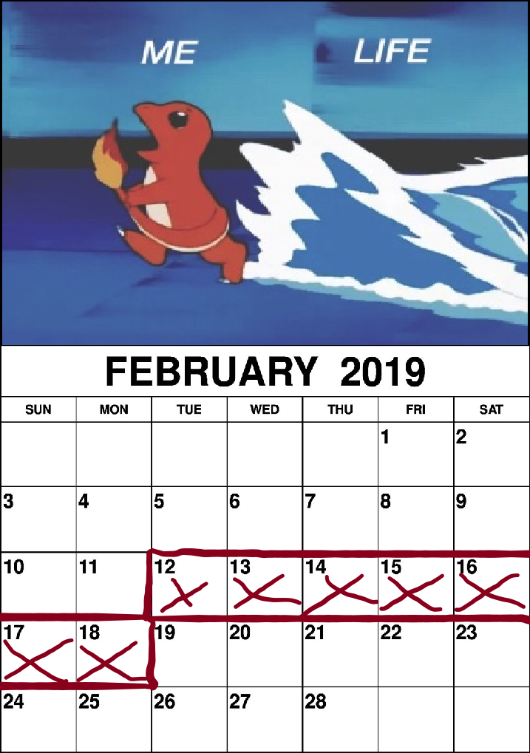
Last Sprint
Worked on programming one of the web scrapers created a abstract class and began working on the food network web scraper
Made Diagrams
Database format and structure
More Diagrams…
Created more issues in Github
Diagrams, Diagrams, Diagrams
Updated Requirements and Specifications Document
…...Diagrams

Slide 3
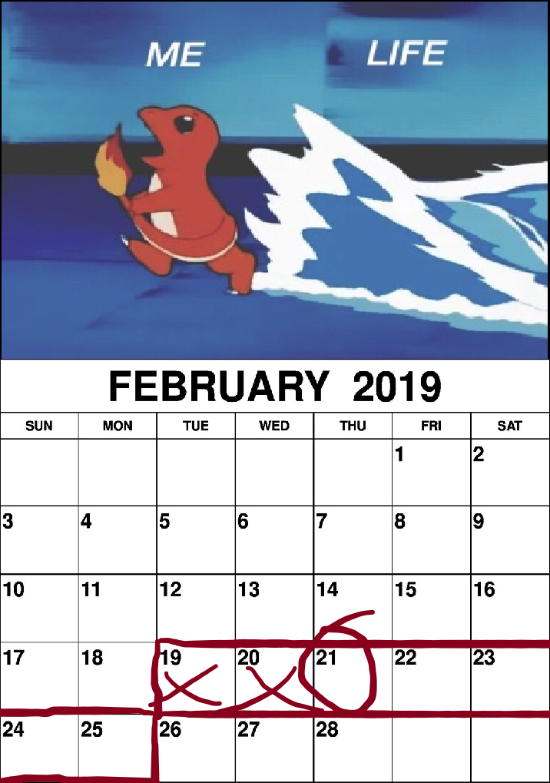
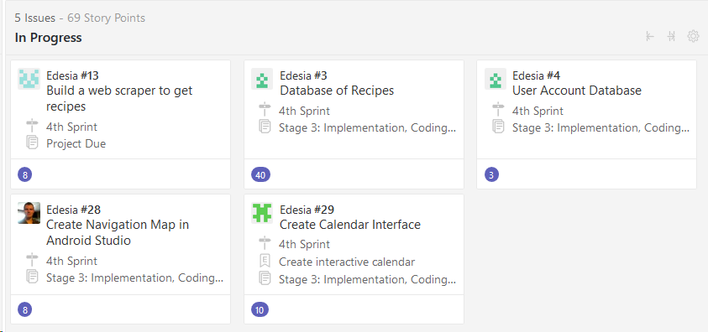
Current Sprint
Create Navigation Map
Create Database for Users and Recipes
Tune-up Web Scraper
Create Calendar Interface

Slide 4
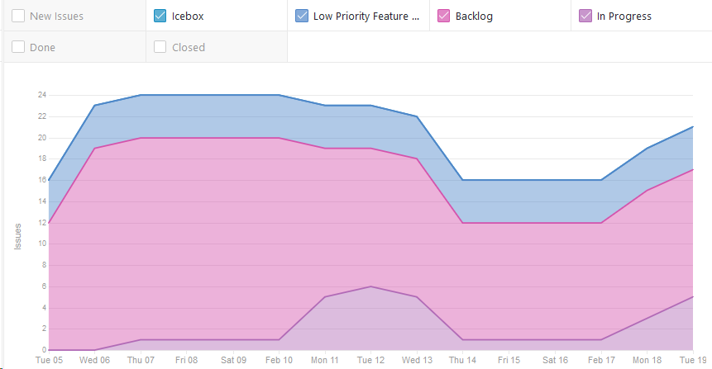
Cumulative Flow

Slide 5
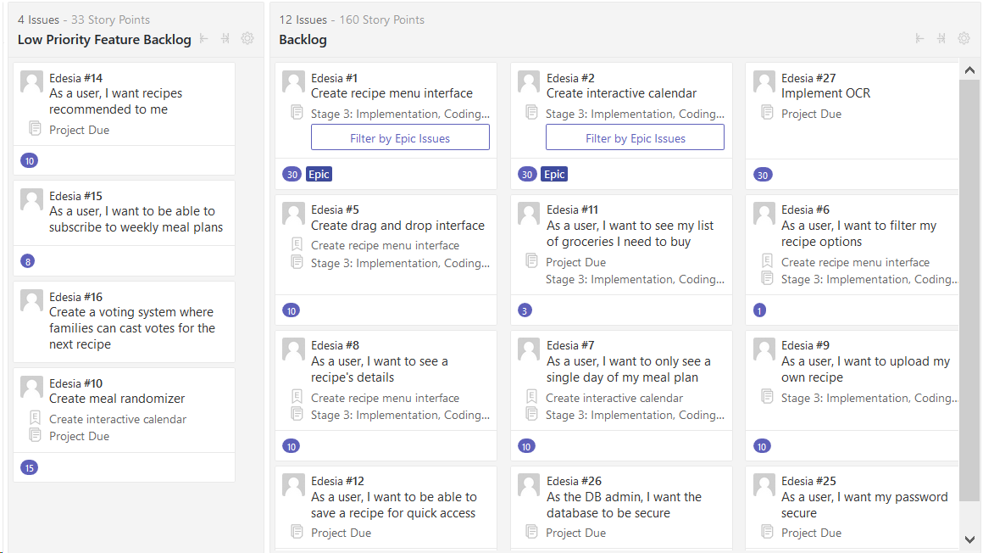
Product Backlog

Slide 6
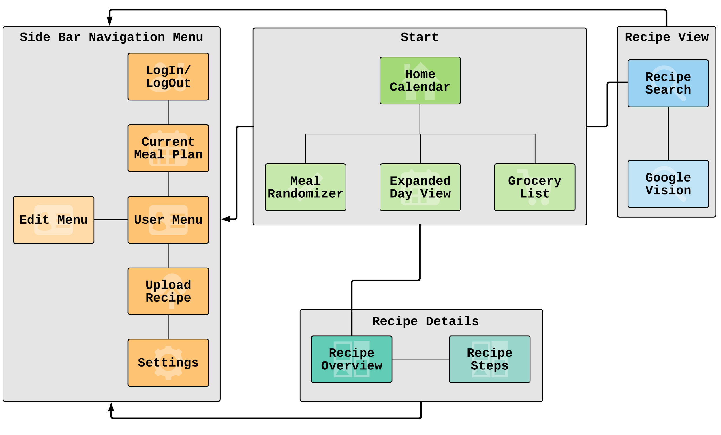
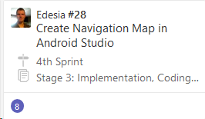
Navigation Map

Slide 7
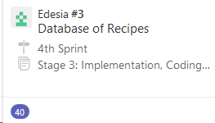
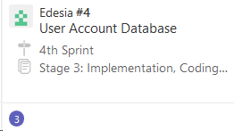
Database
Researching built in functionality of SQLite within AS.
In the process of creating databases, collaborating
with web scraper for specific fields.

Slide 8
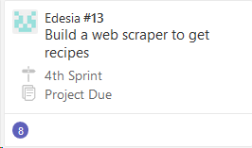
Web Scraper
Web scrapers created a abstract class and began working on the food network web scraper, should have it done by Tuesday's meeting.
So far I was able to get title, ingredients, time, and instructions

Slide 9
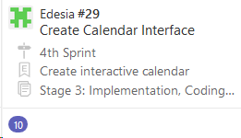
Calendar UI
Balsamiq Mockup
Android studio research

